Slide 1
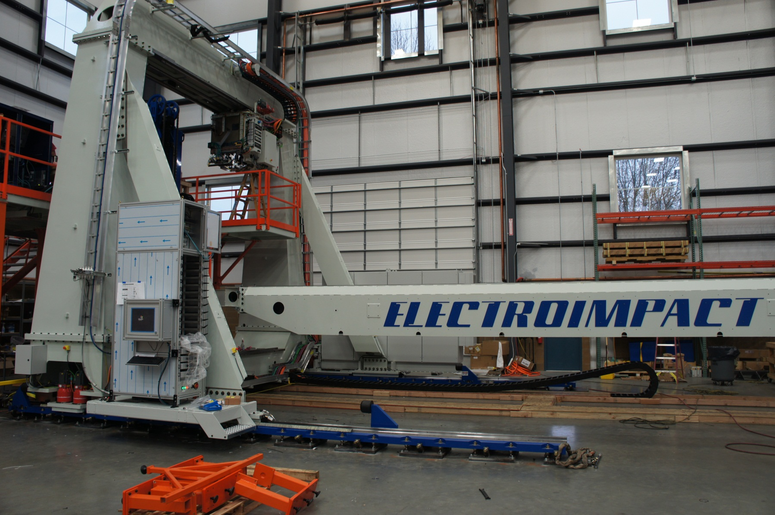
E7000 Main Machine

Slide 2
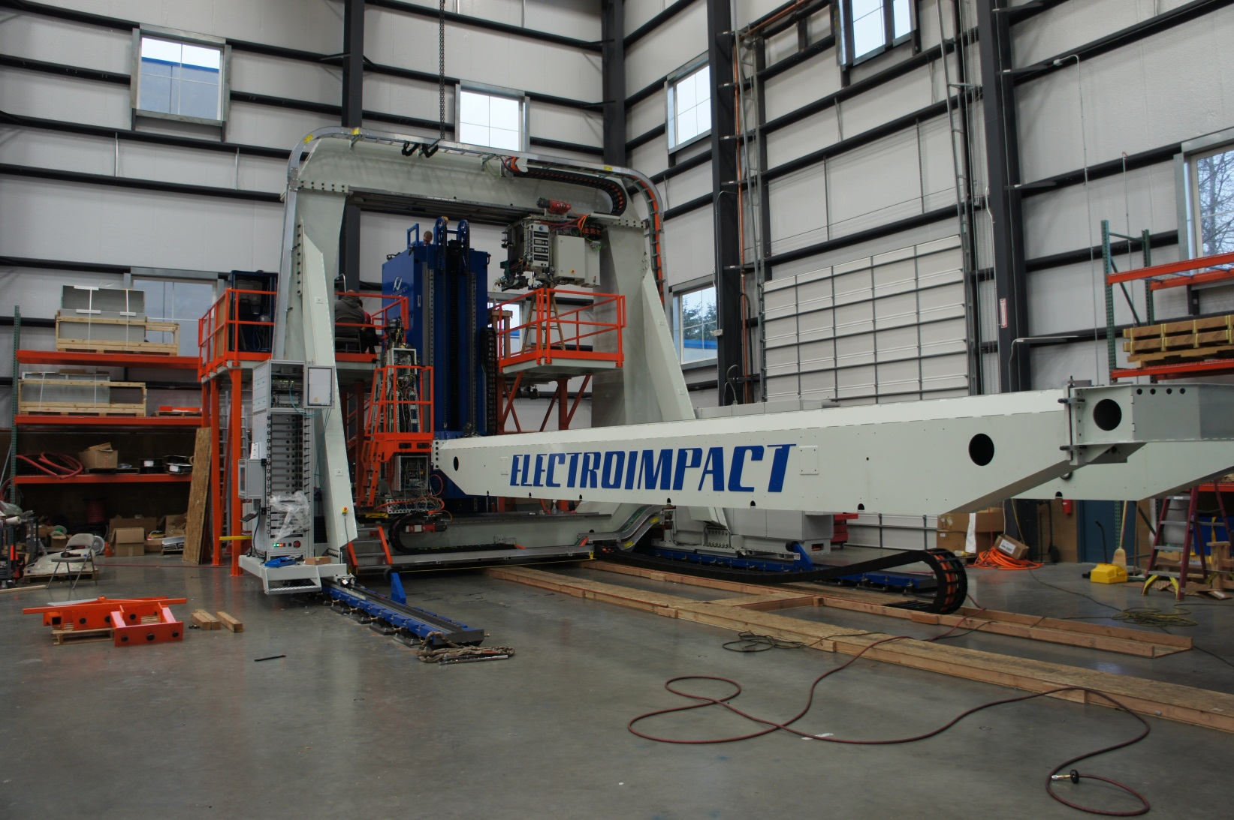
E7000 Main Machine

Slide 3
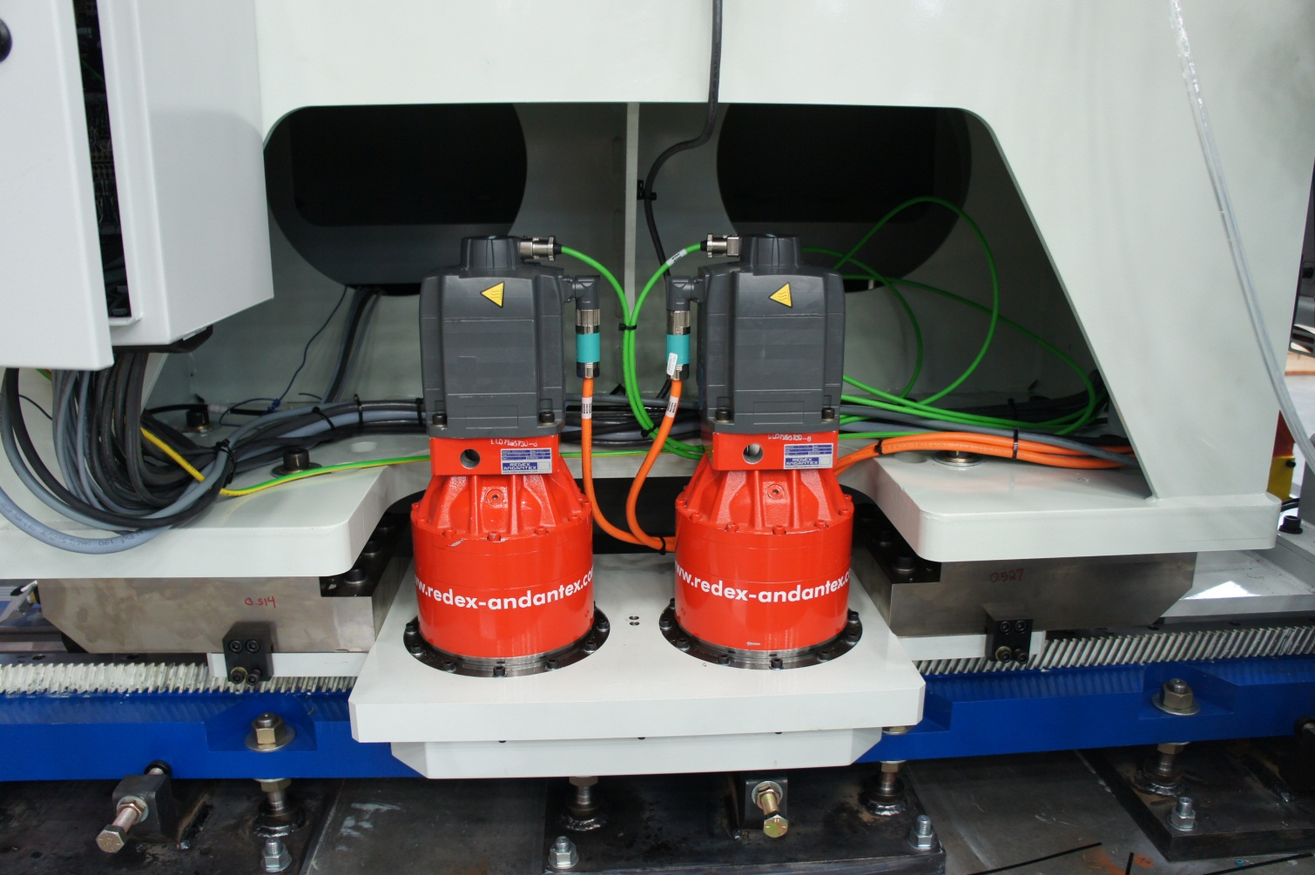
Tandem X Axis Drive for Best Machine Accuracy

Slide 4
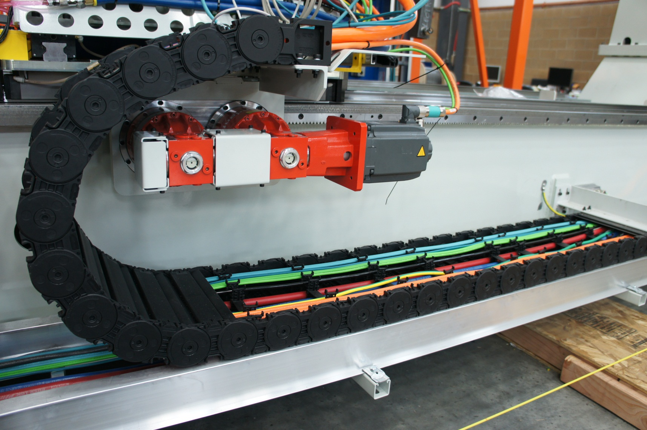
Dual-Drive Gearboxes on Y Axis

Slide 5
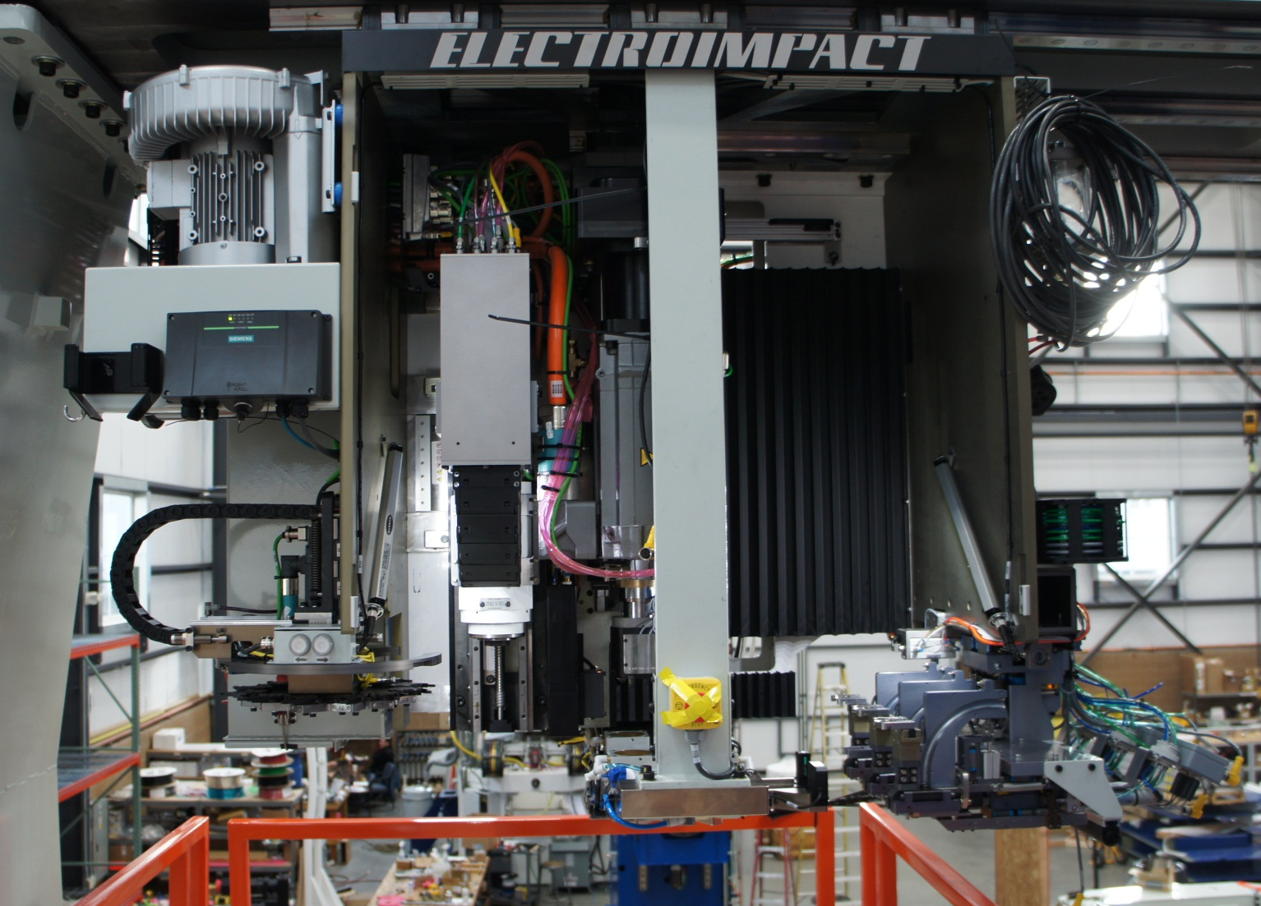
Upper Process Head

Slide 6
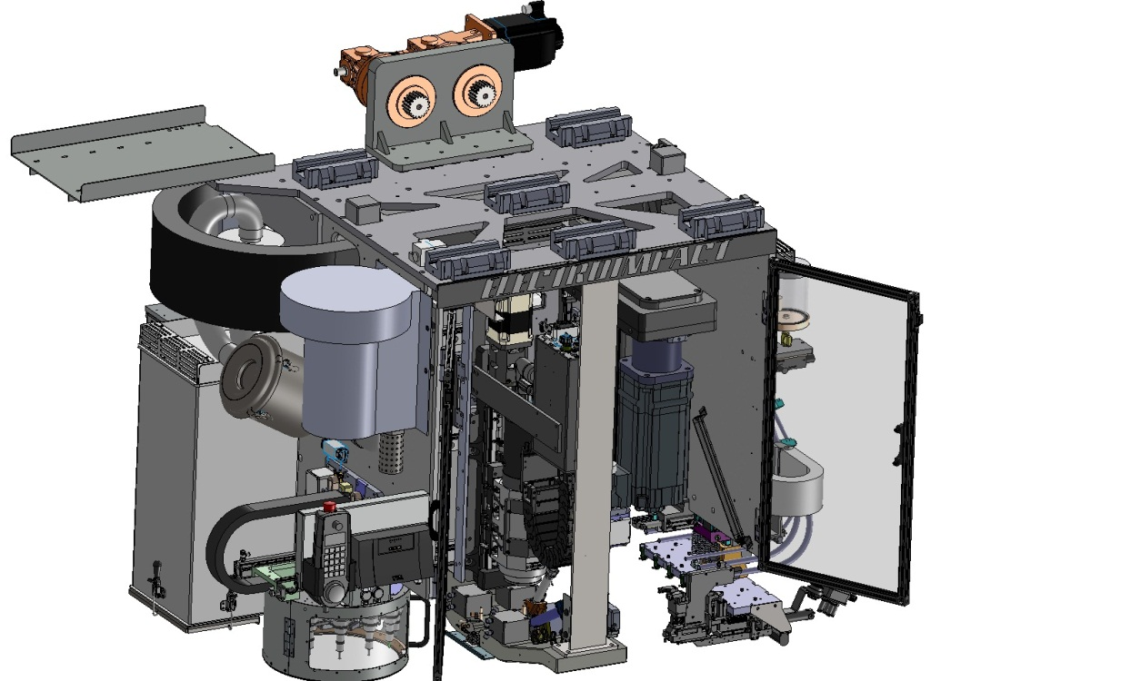
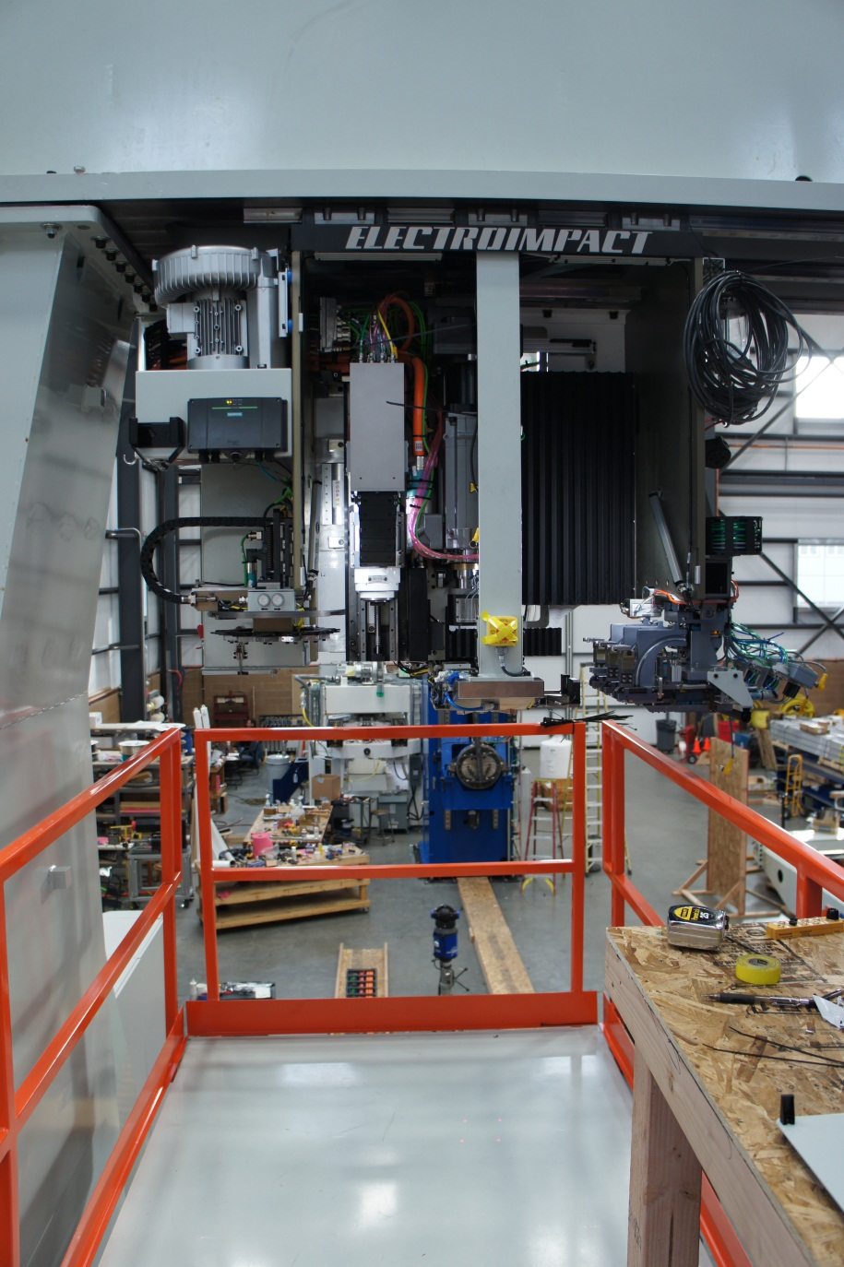
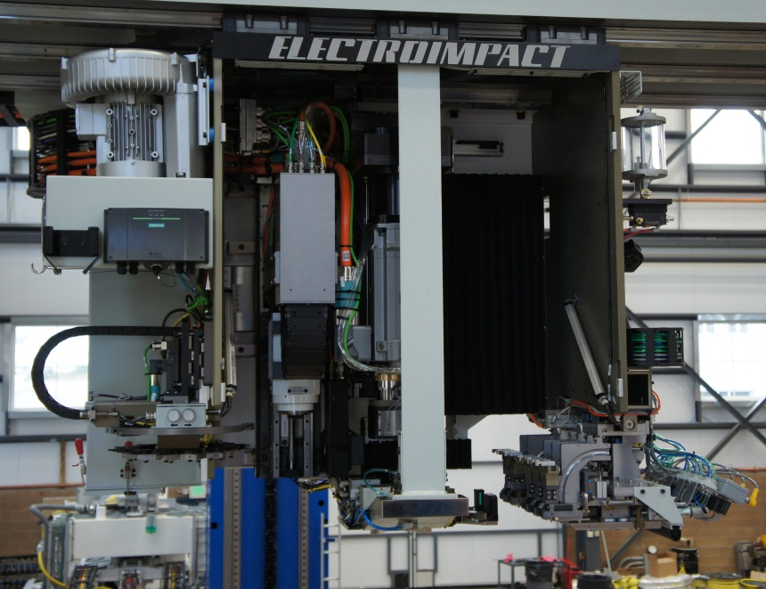
Completely open head design for easy access to process tools

Slide 7
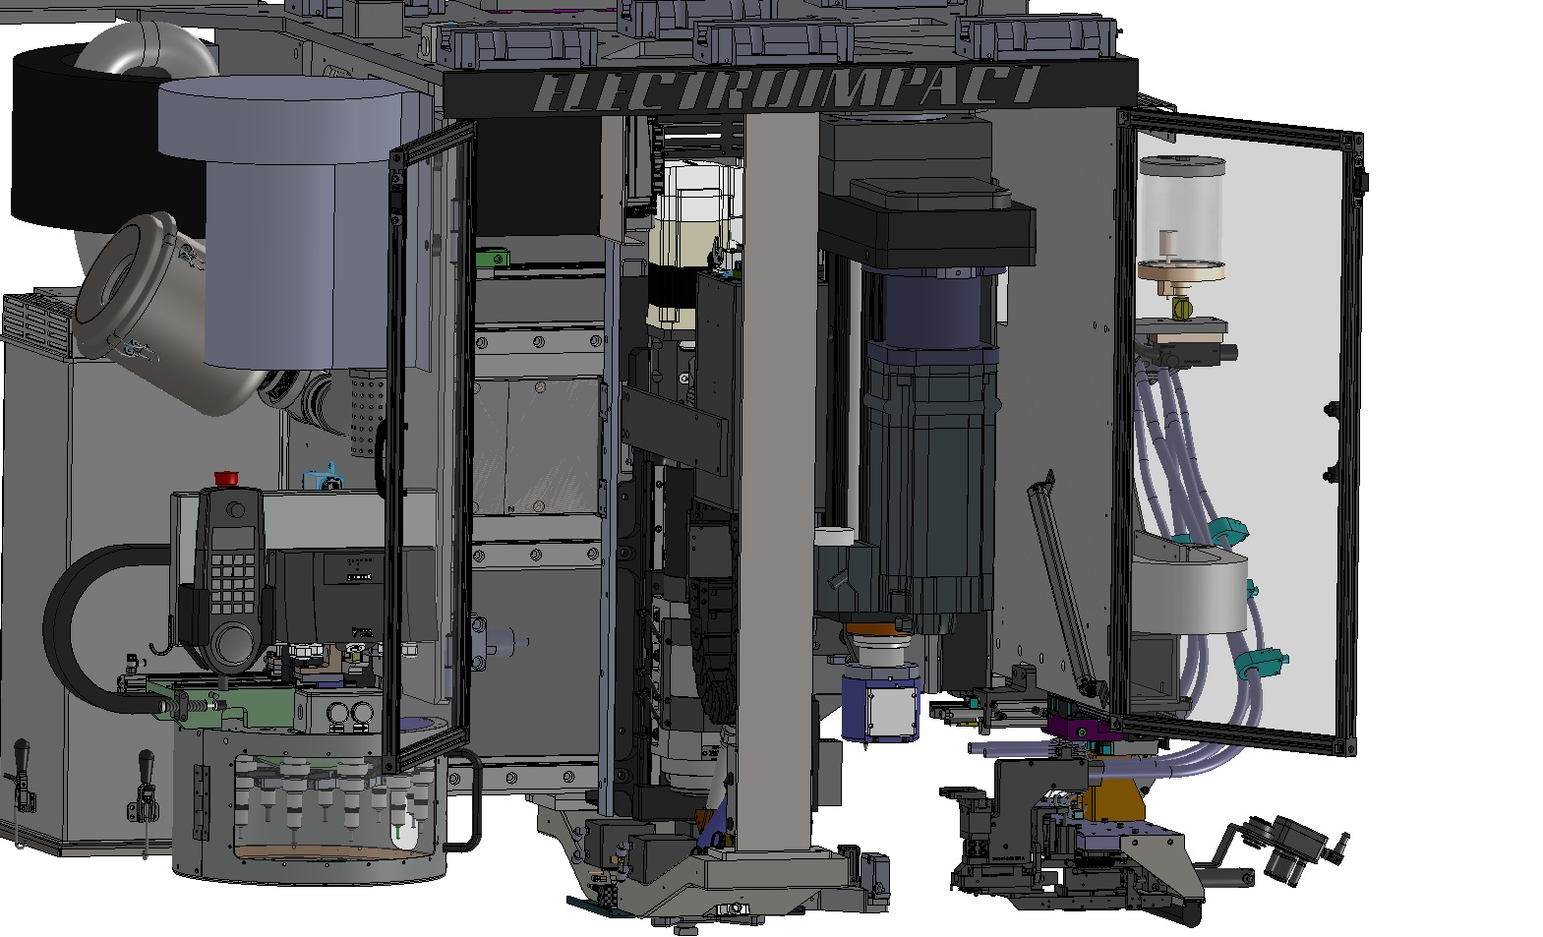
Upper Riveting Head
Driver
Resync camera and flushness laser
Linear motor
Drill spindle
Injectors with automatic anvil tool change
Drill automatic tool changer
Sealant inserter

Slide 8
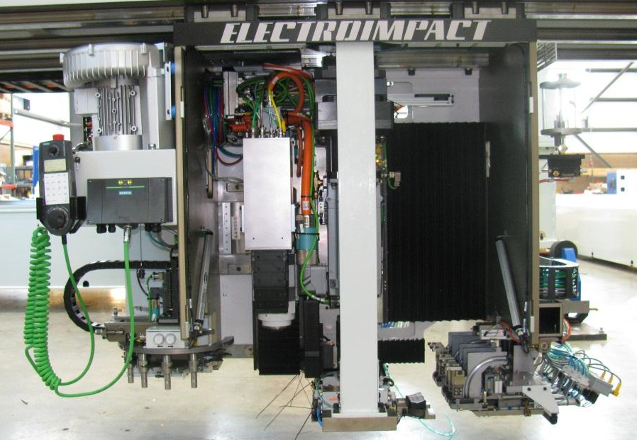
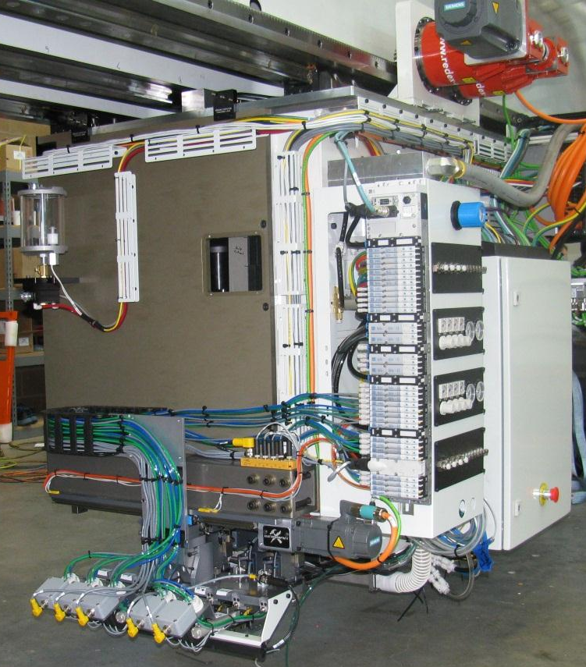
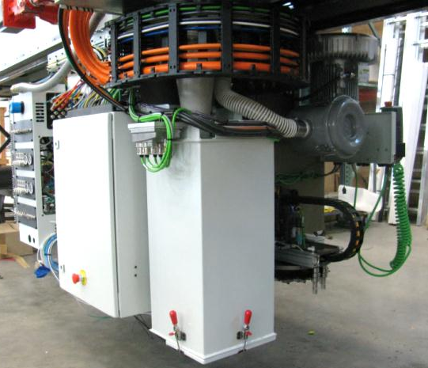
Upper Head Overview
Headstone Assembly
Accu-Lube unit
Automatic Tool Changer
Process tools mounted on a linear motor controlled shuttle table
Automatic fastener injector modules
Chip vacuum system

Slide 9
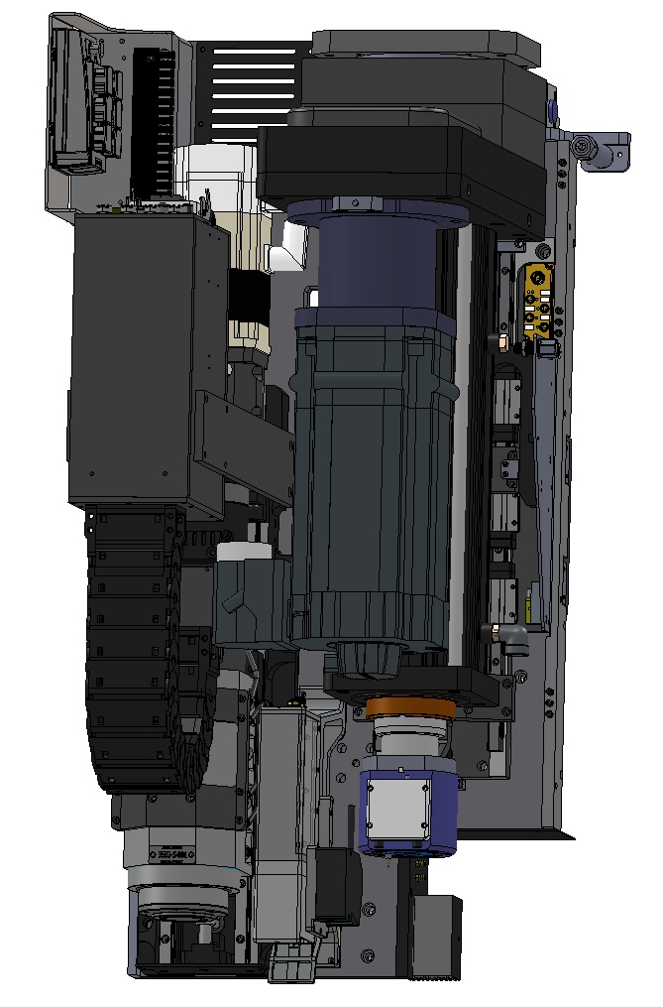
Process Tool Layout
Resync Camera
Very fast tool shuttling time
  250 ms transition from drill to buck tool
244 mm from drill to buck tool
Exlar Roller Screw Actuated Rivet Driver
Drill
Flushness Laser

Slide 10
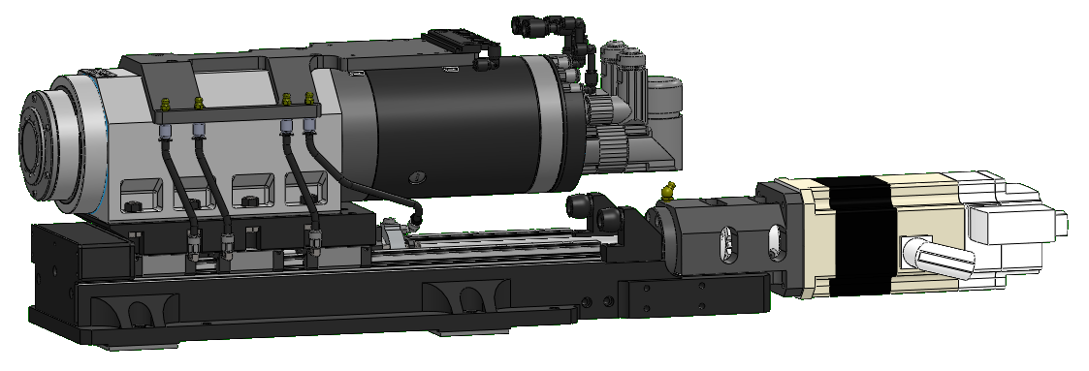
Spindle
  Spindle Assembly
    Precise SD60124 E1107 spindle cartridge
    Heidenhain LC495S absolute linear encoder (5 µm accuracy)
    Bosch-Rexroth 20x10R rolled ball screw, size 15 linear bearings
    1FK7042-2AK71-1CH1 Siemens servo motor with brake (feed axis)
    Self-contained connectorized electrical bulkhead
    A&A Gortite bellows for chip protection
    Easy-access remote greasing for bearings
    Tribos HSK-40E tool holder

Slide 11
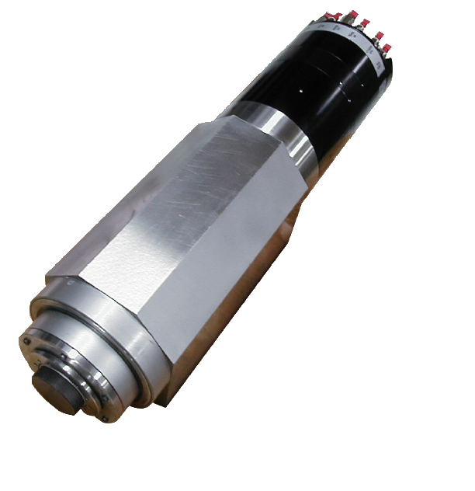
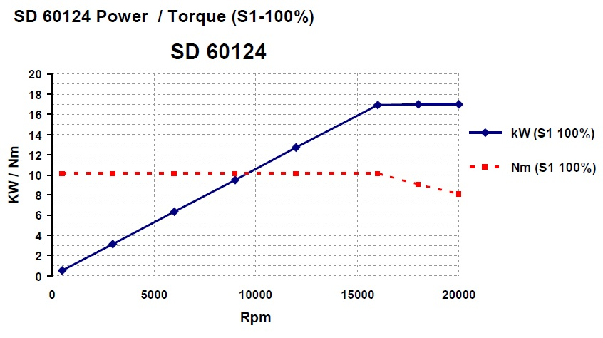
SD60124 Spindle Cartridge
Fischer-Precise SD 60124 spindle with custom housing:
  AC synchronous, 3-phase, 4-pole motor
  Speed range of 500 - 20,000rpm
  10.1 N-m (89.4 in-lb) nominal torque
  17 kW (22.8 hp) at full speed
  4 angular-contact, hybrid-ceramic bearings
  Permanent grease lubrication
  Dowtherm liquid coolant circulation through housing
  PTC thermistor and PT100 temperature sensors
  HSK 40-E clamping system with spring-loaded drawbar (pneumatic release)
  Integrated PNP proximity sensors to detect tool holder EI has supplied nearly 45 spindle assemblies over 10 projects that use this cartridge

Slide 12
Upper Head Maintenance Access

Slide 13
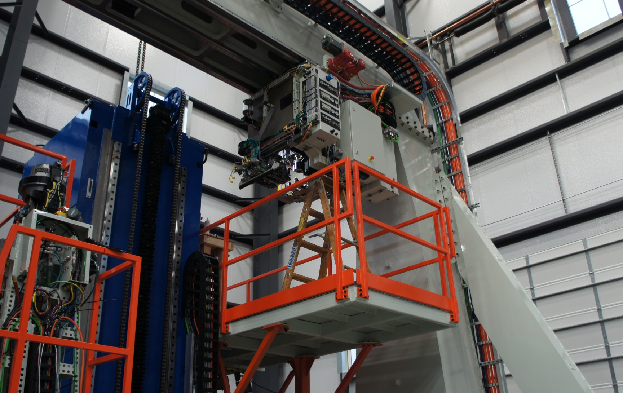
Upper Head in Maintenance Position

Slide 14
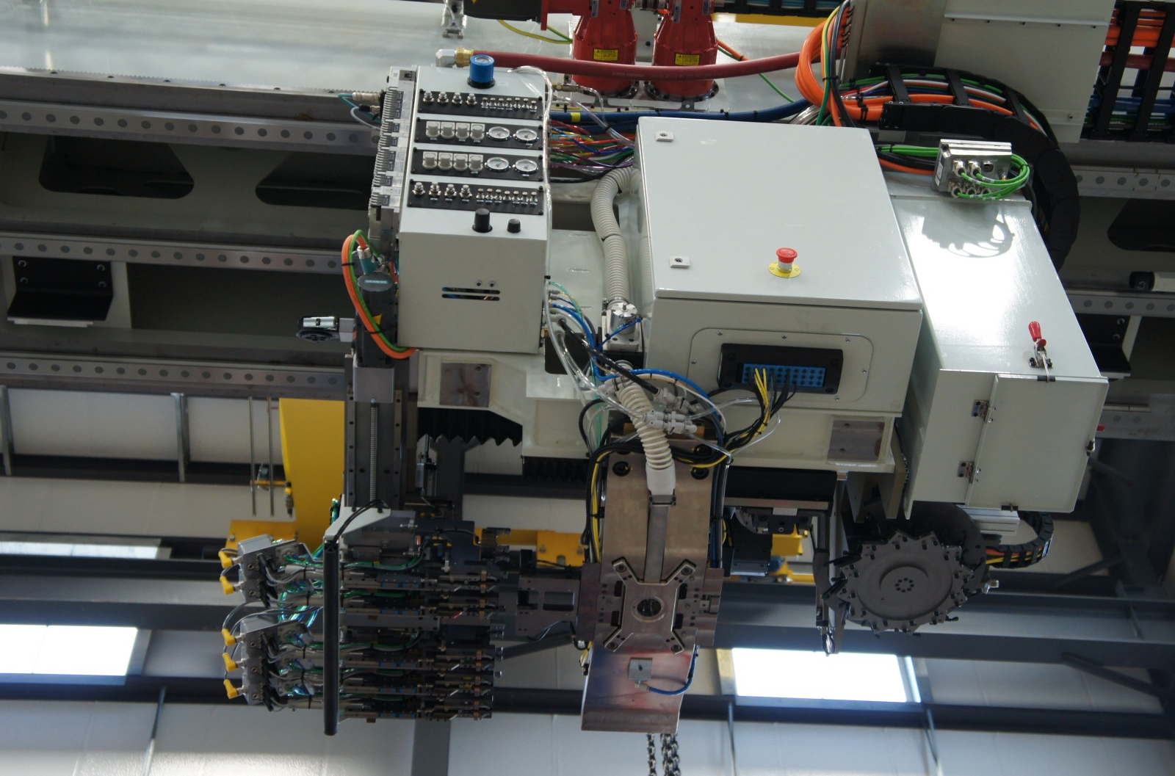
Headstone and Pressure Plate

Slide 15
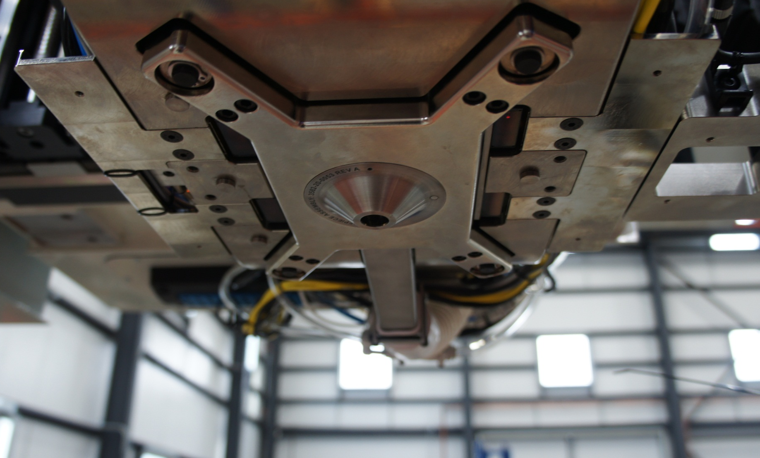
Upper Pressure Plate
Swappable Nosepiece – no tools needed

Slide 16
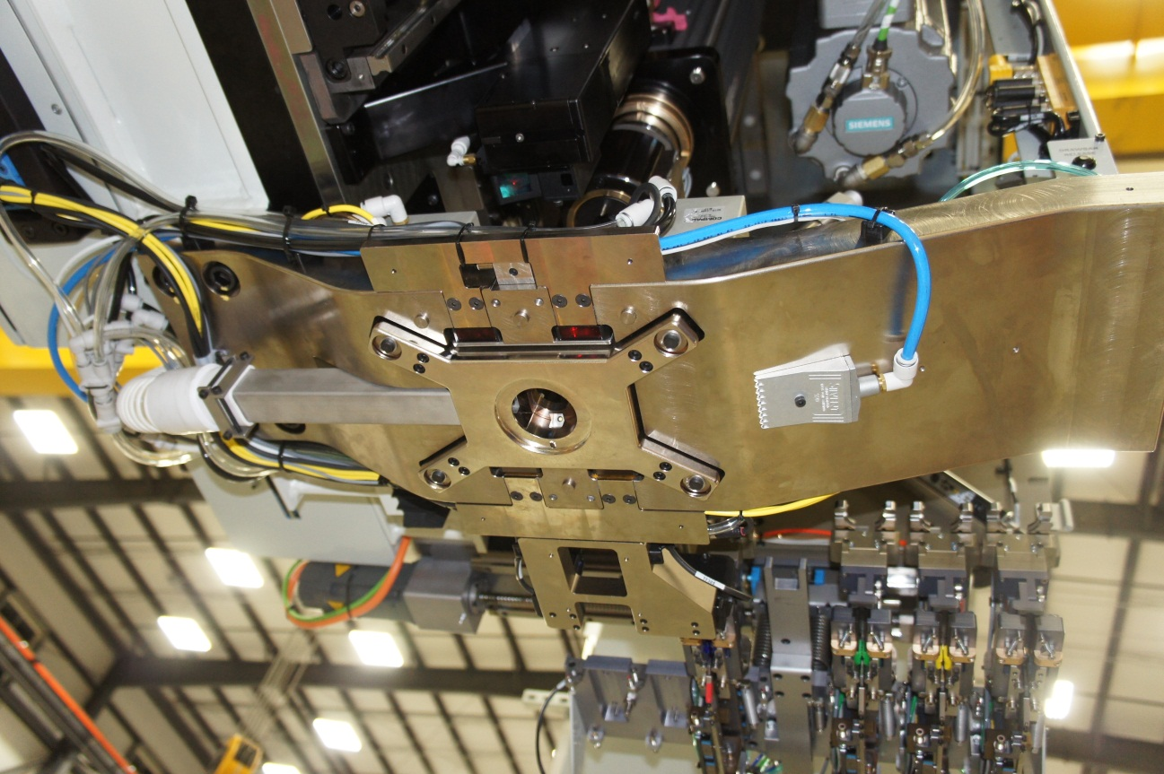
Headstone
(4) Baumer Laser Normality Sensors
Chip Vacuum Line
Panel Chip Blow-Off
Pressure Foot (moves independently from surrounding headstone structure)

Slide 17
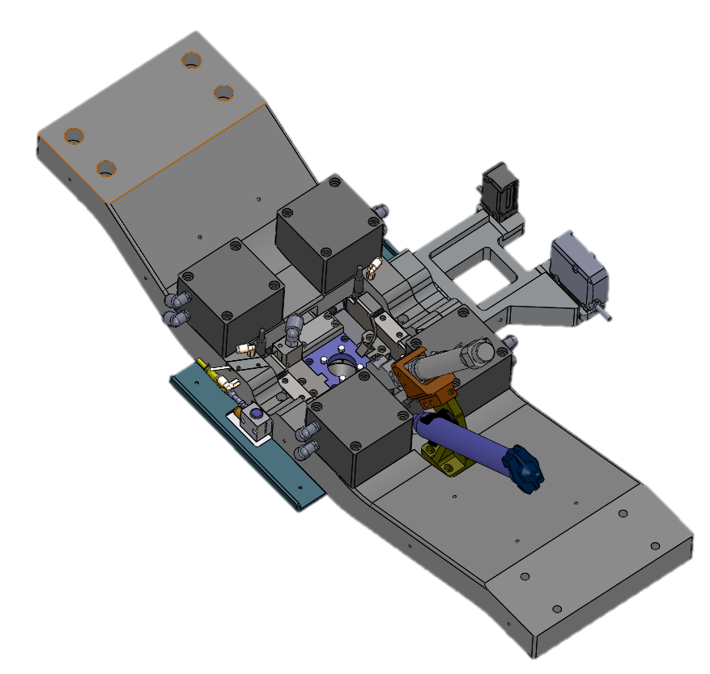
Headstone
(4) Air Cylinders control the independent pressure foot
Rivet Length Check Laser
Sealant Inserter
Broken Drill Bit Detection Laser
Compliant Touch-off (drill bit length measurement)

Slide 18
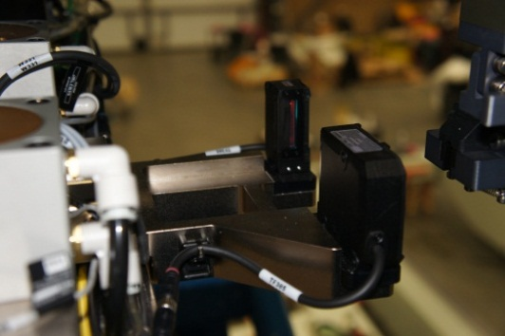
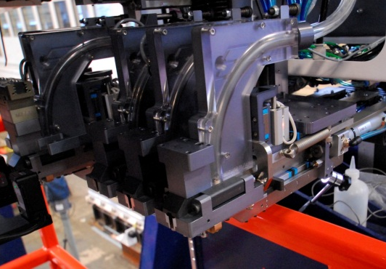
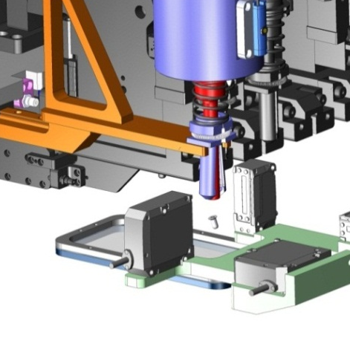
Existing Upper Head Features
Length Check Laser
Light curtain measures length of rivet/bolt in fingers
Also senses if rivet is not present
Bomb Bay Doors
Automatically ejects backwards fasteners or multiple fasteners
Auto Fastener Eject
Incorrect fastener is automatically rejected

Slide 19
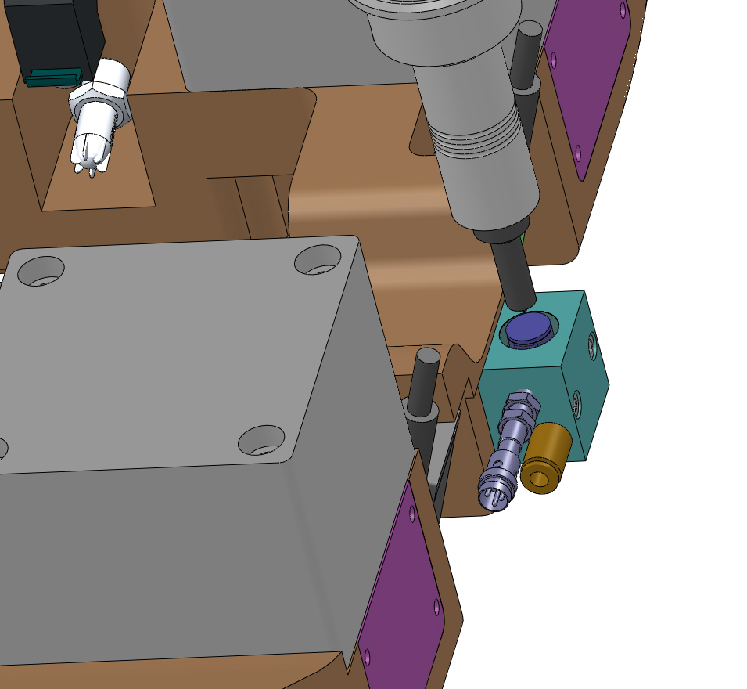
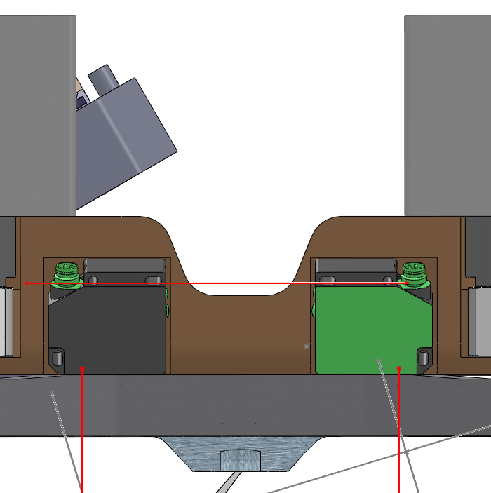
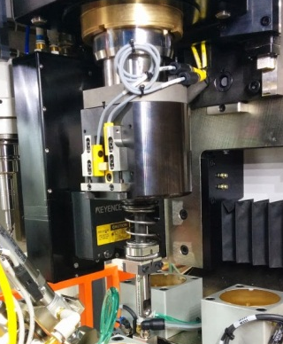
Existing Upper Head Features
Compliant Touch Off
Cutter length measurement
Prox switch detects touch off and records the cutter length
Broken Drill Bit Detection
Drill bit breaks beam before drill extends to panel
Automatic feed hold if the drill bit detected is not the correct length
Air Gap Panel Protection
Can detect tipped rivets without damaging the panels

Slide 20
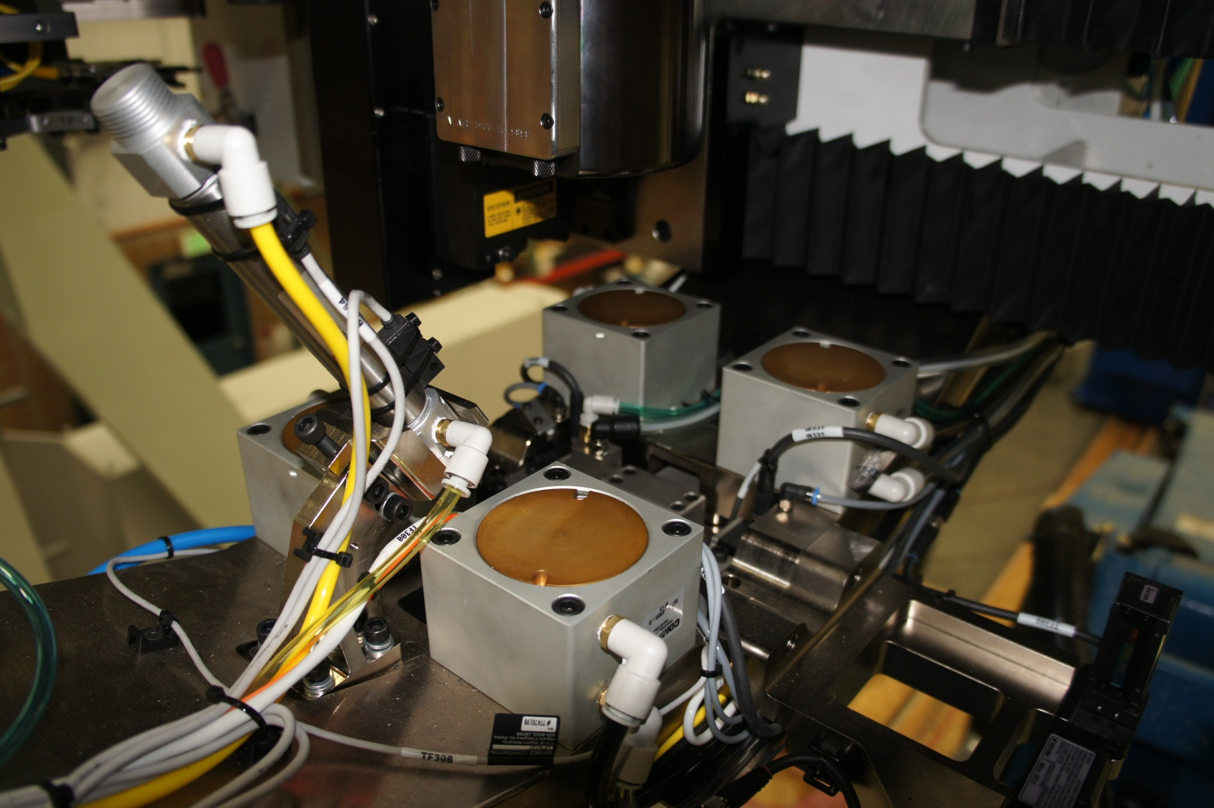
Inside Headstone

Slide 21
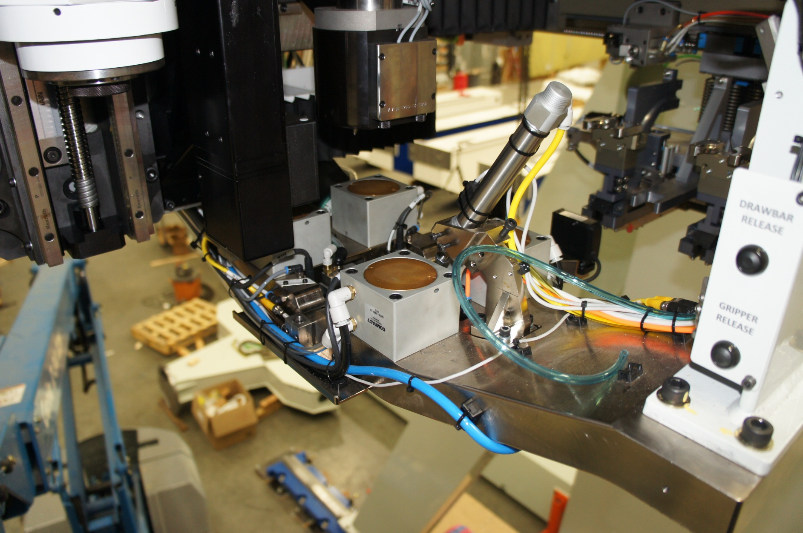
Inside Headstone

Slide 22
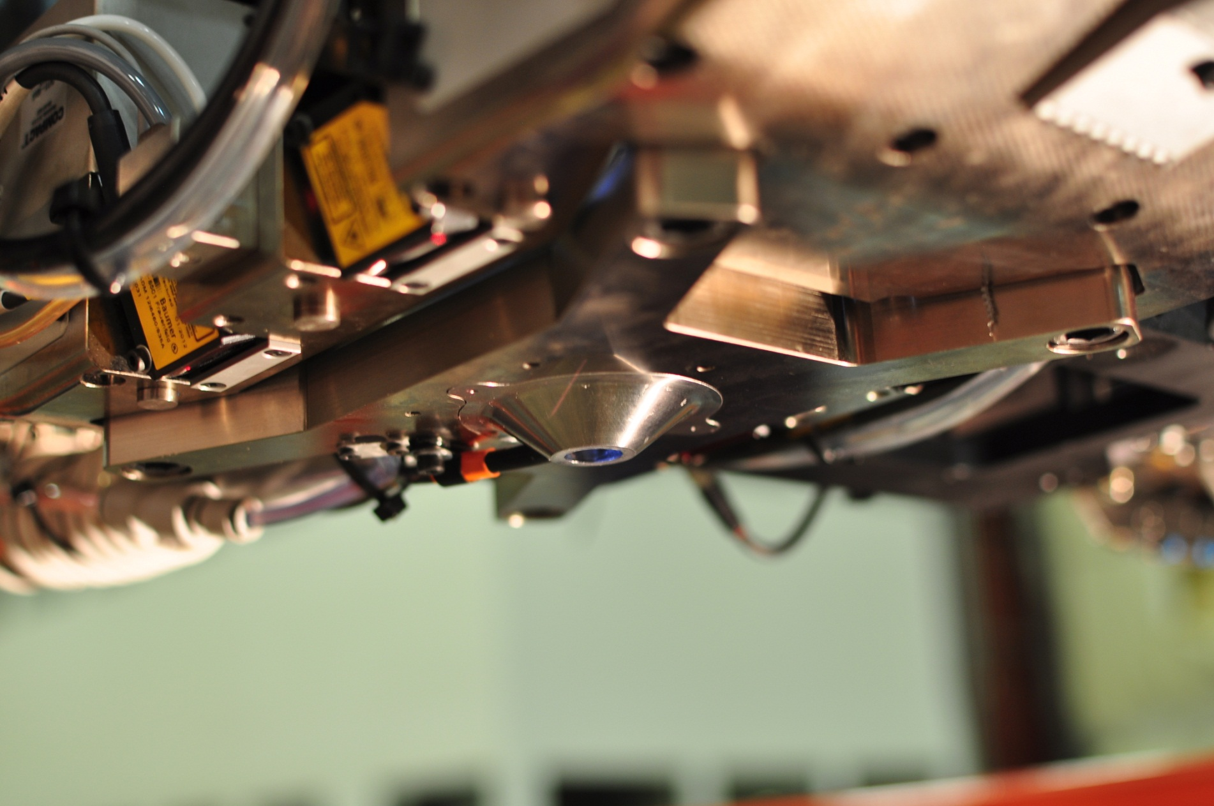
Pneumatic Clamp Extended

Slide 23
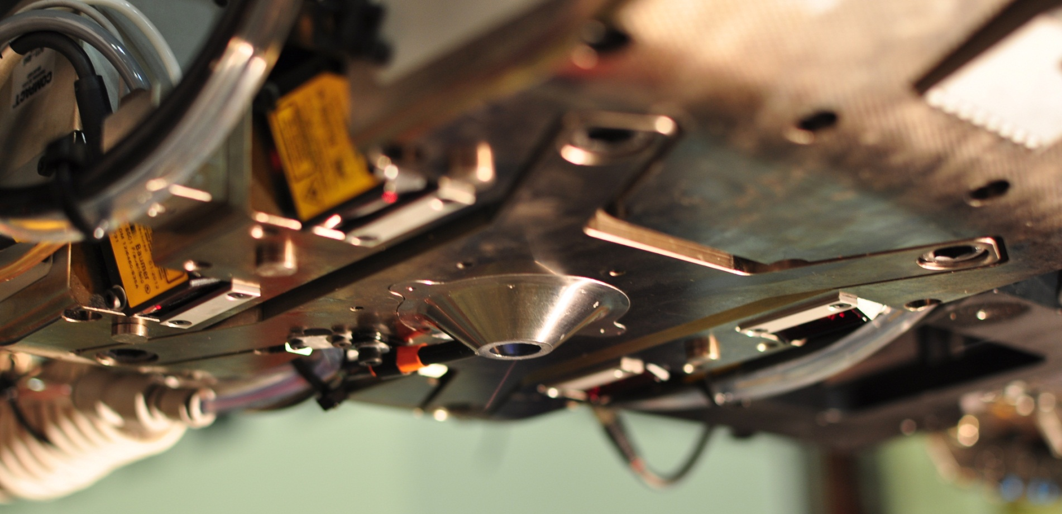
Pneumatic Clamp Retracted

Slide 24
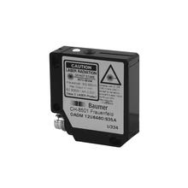
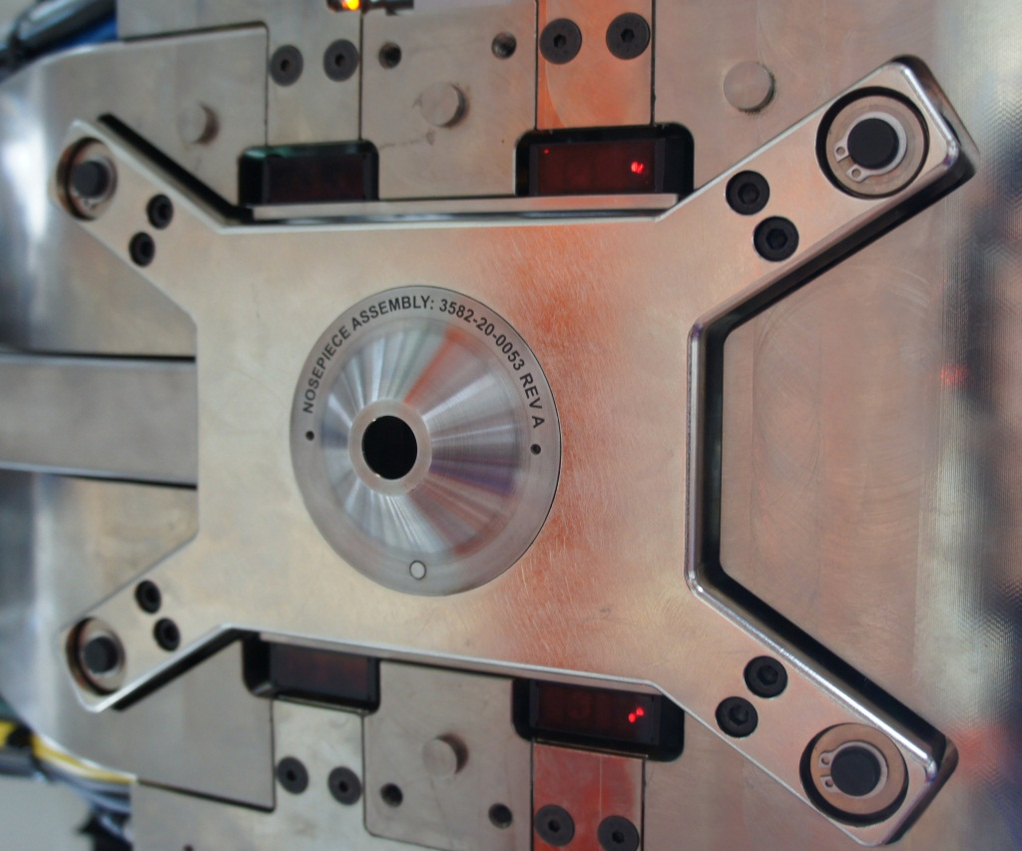
Laser Normality Sensors
Baumer OADM laser distance measuring sensors
Normalizes panel and maintains constant fly height
16-120mm measuring range

Slide 25
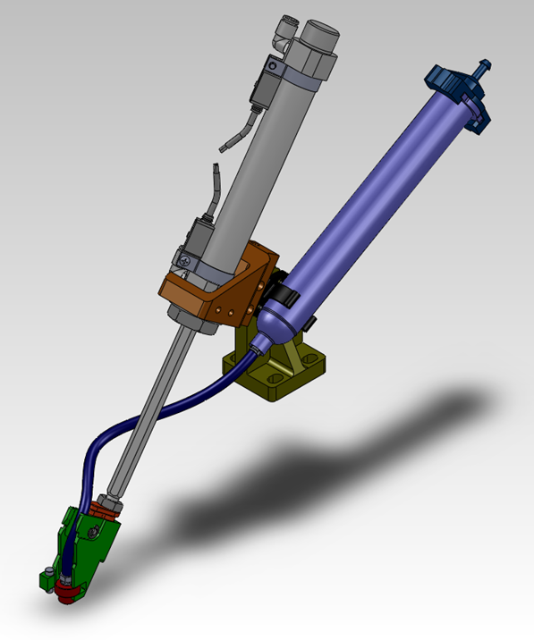
Sealant Inserter
Headstone Mounted
Pneumatically Controlled Dispense
Convenient Consumables Management
Single Cylinder Delivery

Slide 26
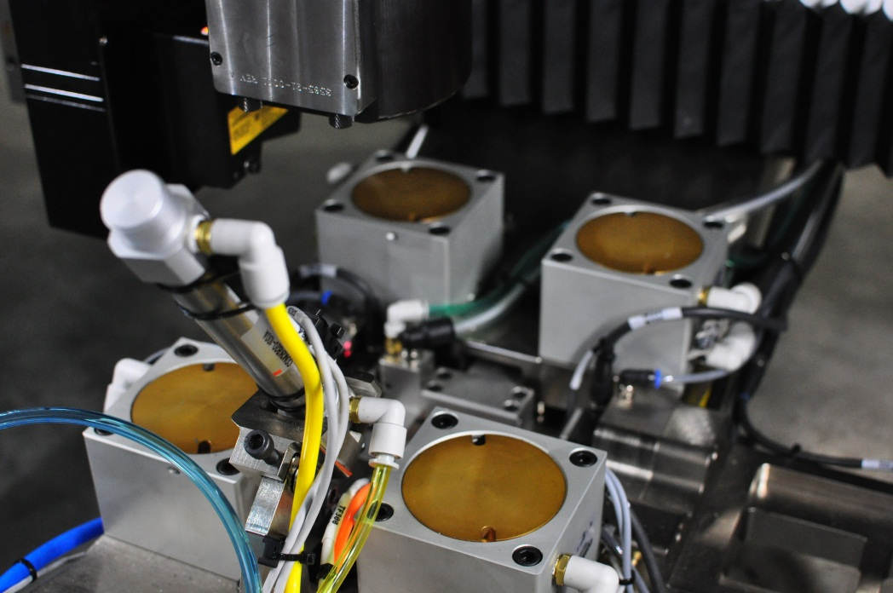
Sealant Inserter
Headstone Mounting
Minimal to no impact on cycle time
Sealant injected during Drill -> Driver shuttle move
Total sealant cycle time 200-500ms

Slide 27
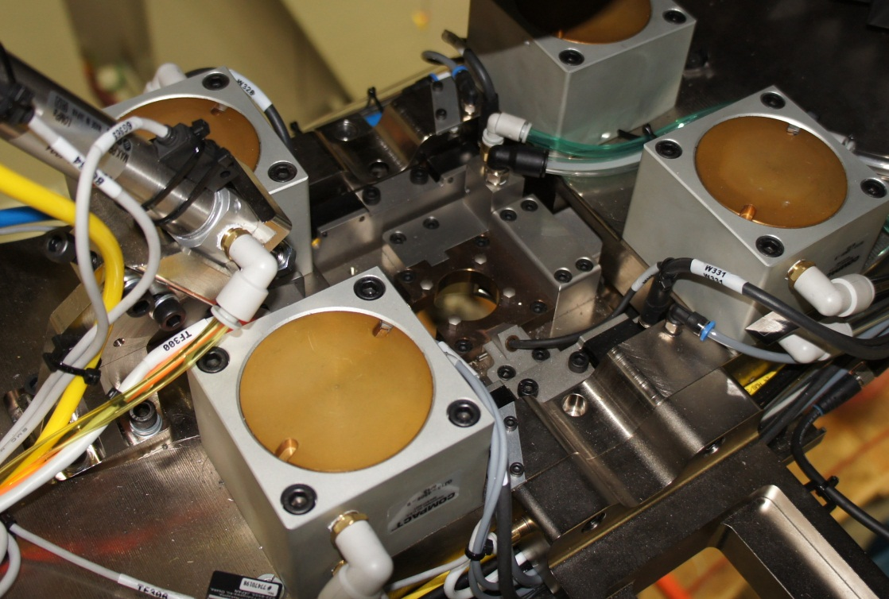
Broken Drill Bit Detection
Drill bit breaks beam before drill extends to panel

Slide 28
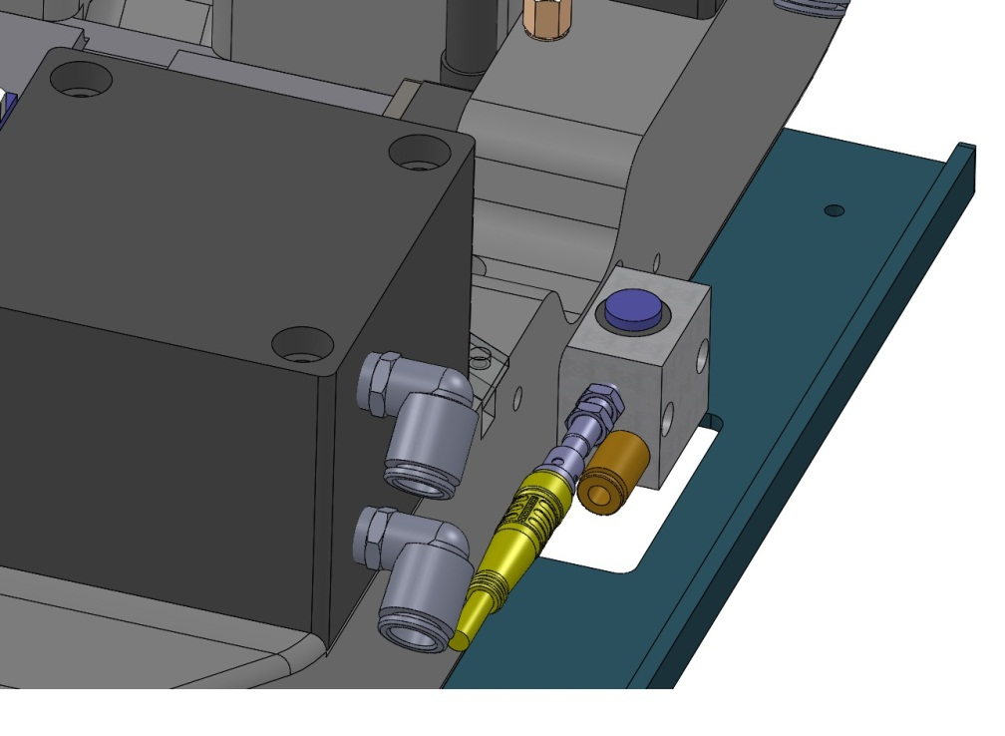
Compliant Touch Off
Cutter length measurement
Blue button floats in housing
Prox switch detects touch off and records cutter length

Slide 29
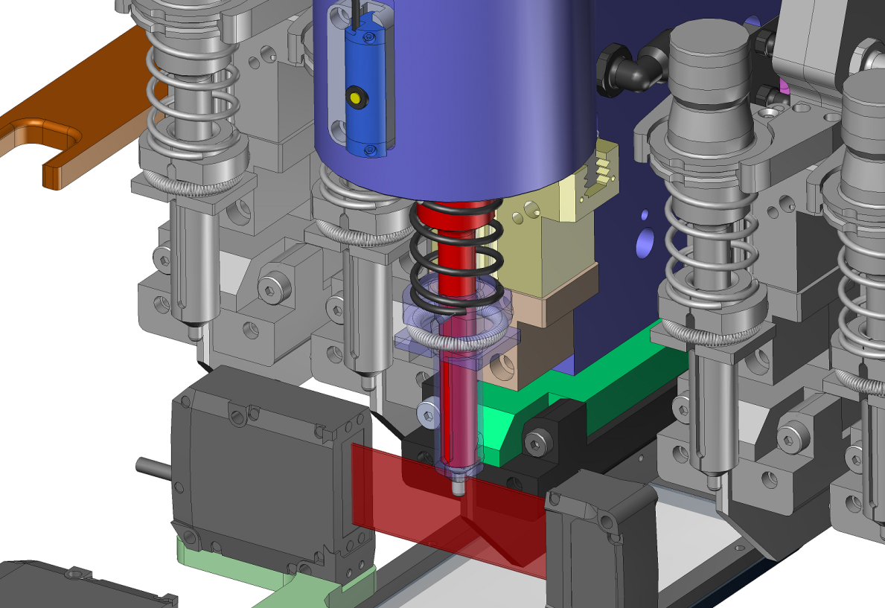
Fastener Length Verification
Light curtain measures length of rivet/bolt in fingers
Also senses if rivet is not present

Slide 30
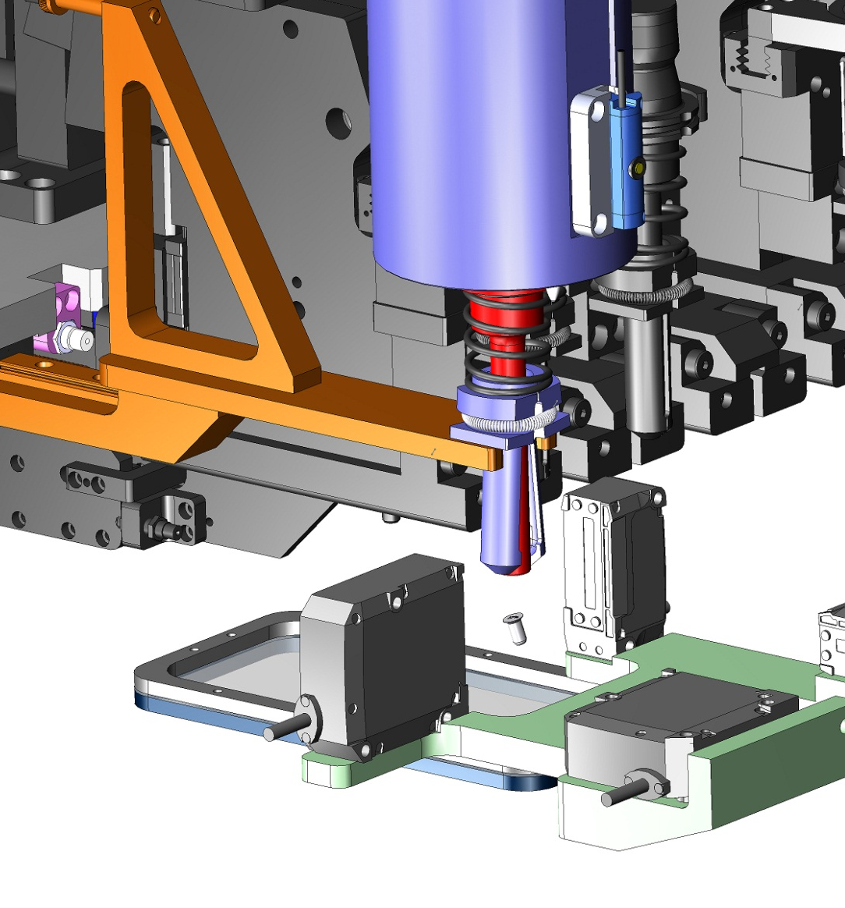
Fastener Eject
Incorrect fastener is automatically rejected

Slide 31
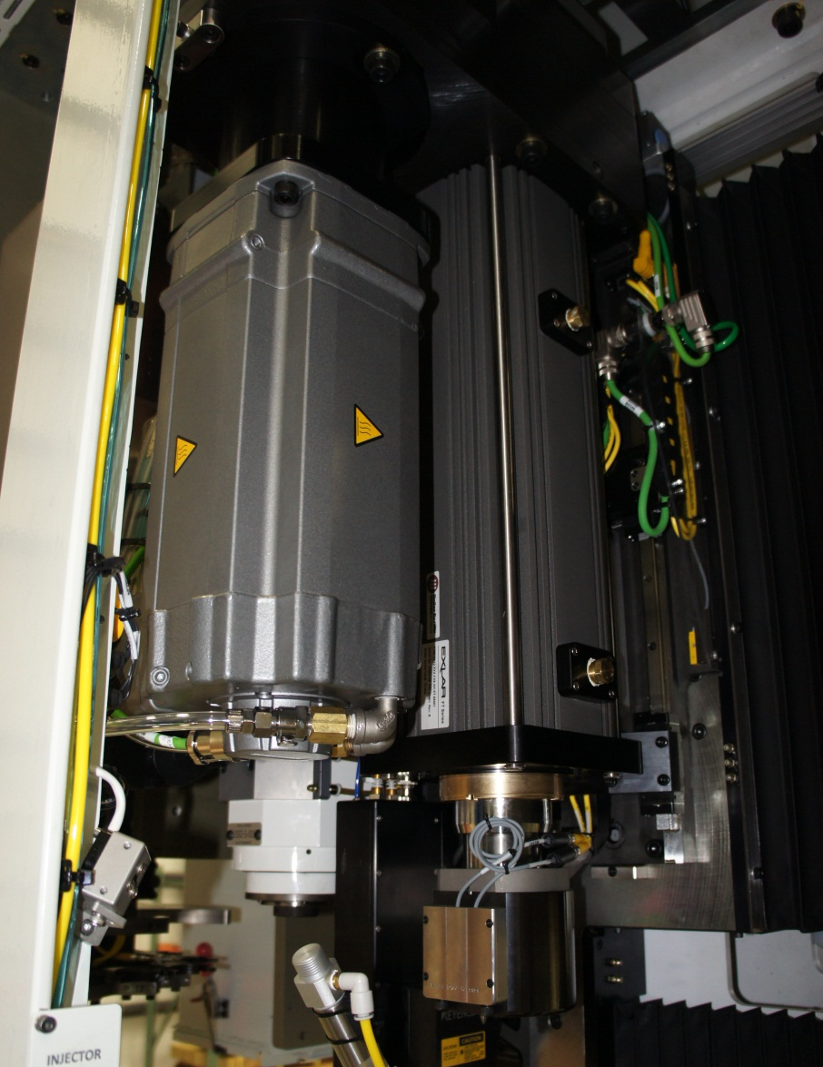
Rivet/Bolt Driver Tool

Slide 32
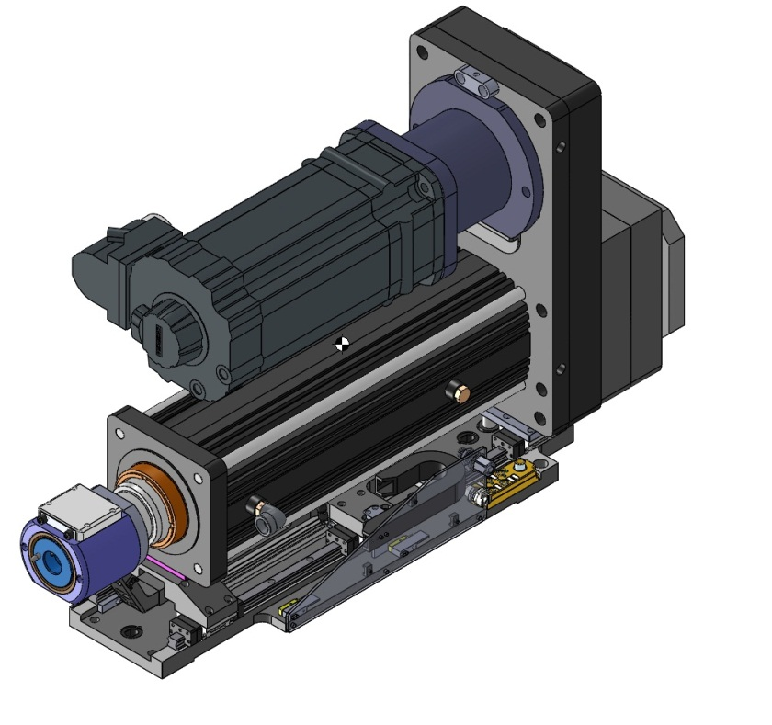
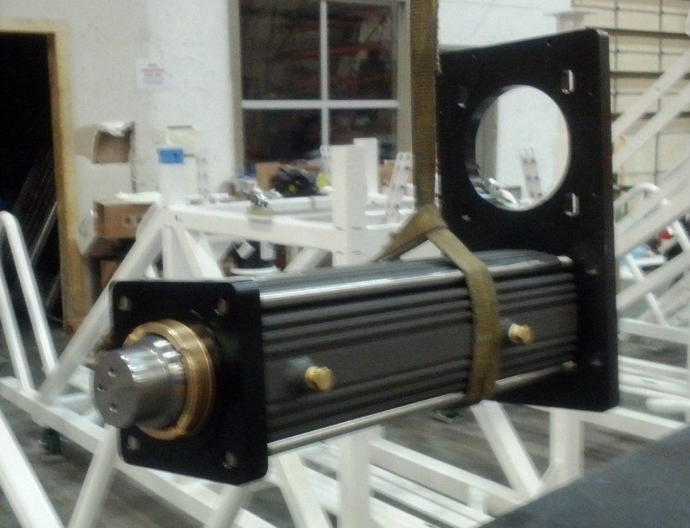
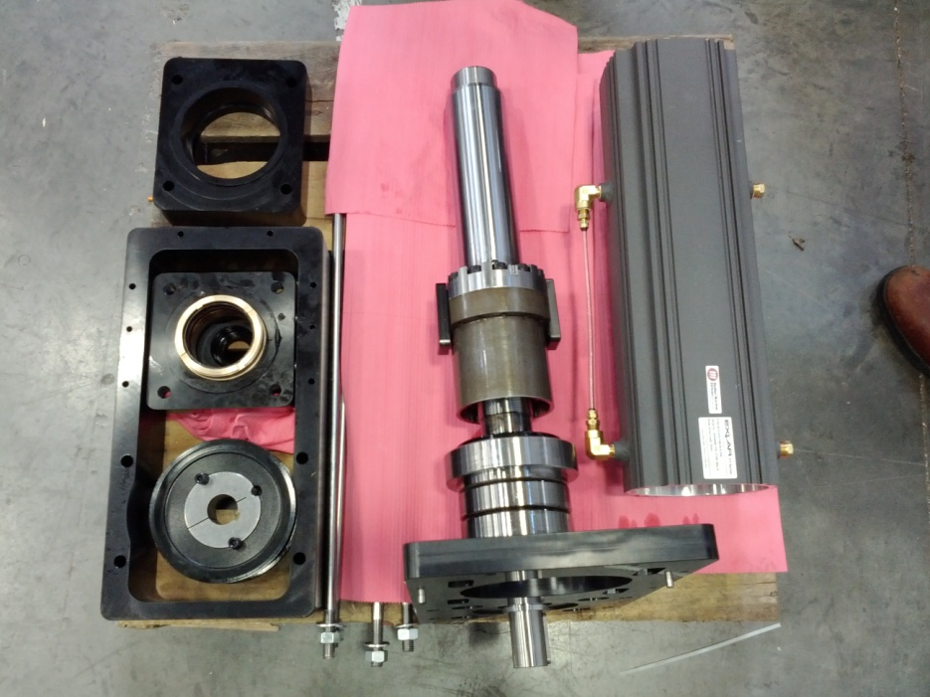
Driver
Design based around the Exlar FT60 series linear actuator

Slide 33
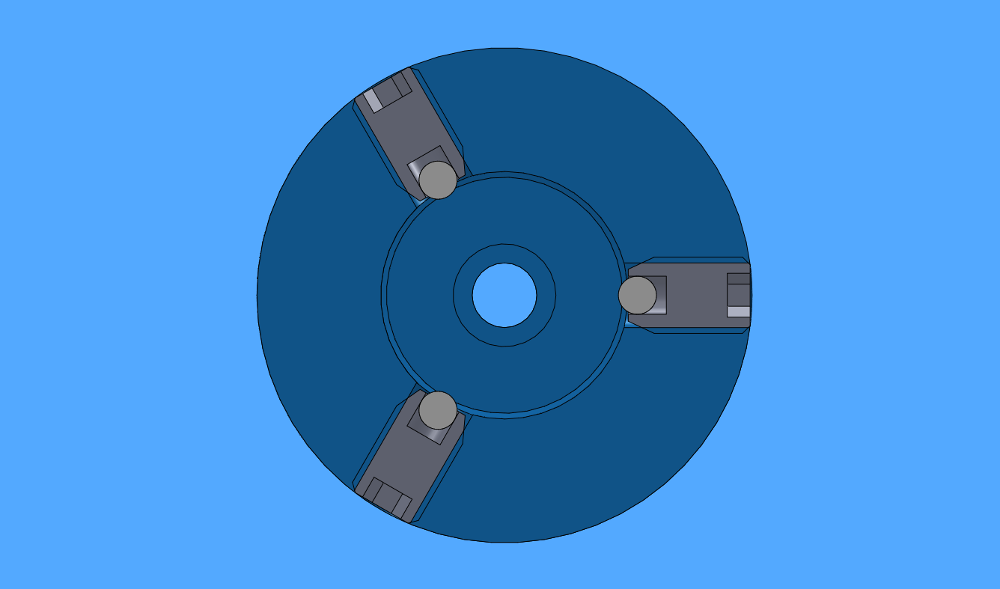
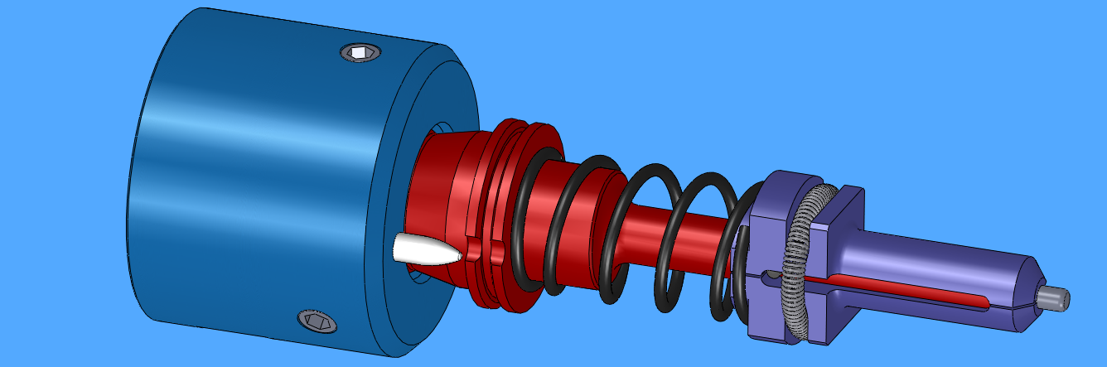
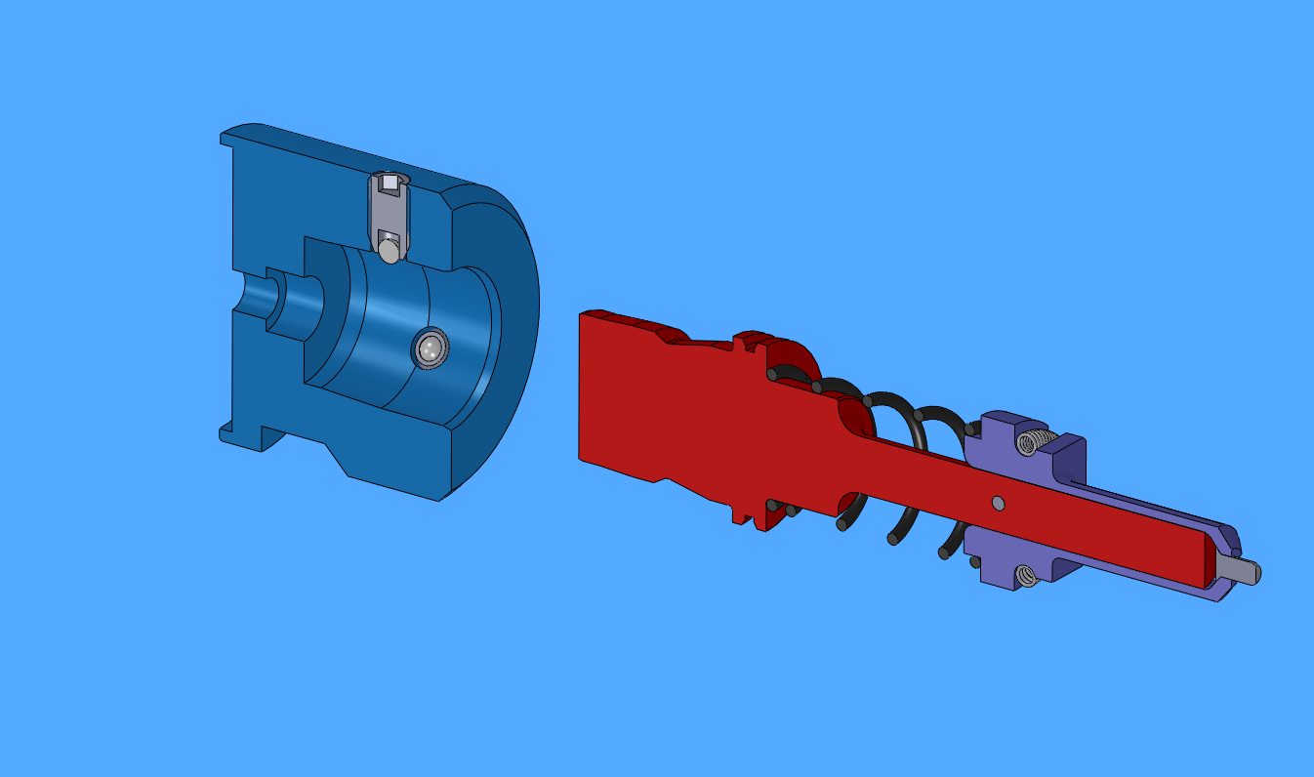
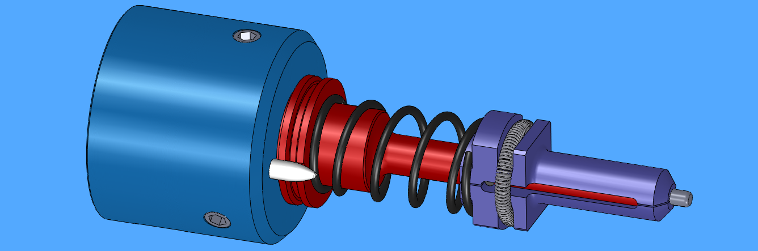
Anvil Socket
Bullet-nose pin ensures correct tool alignment
Tolerates ±8° misalignment during insertion
Ball detent retention mechanism

Slide 34
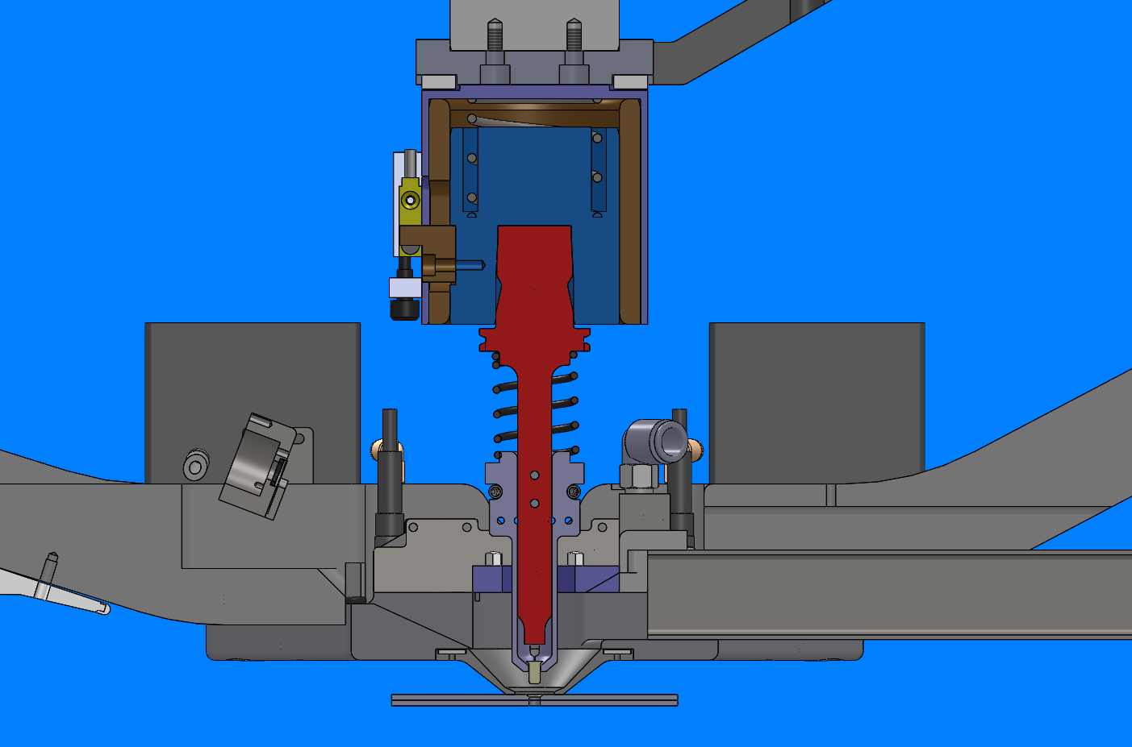
Air Gap Panel Protection
Air gap
Anvil socket
Air gap sensor
Rivet anvil
Rivet
Pressure foot/Clamp pad
Panel

Slide 35

Air Gap Panel Protection
Rivet inserter
Air gap sensor
Anvil socket
Rivet anvil

Slide 36
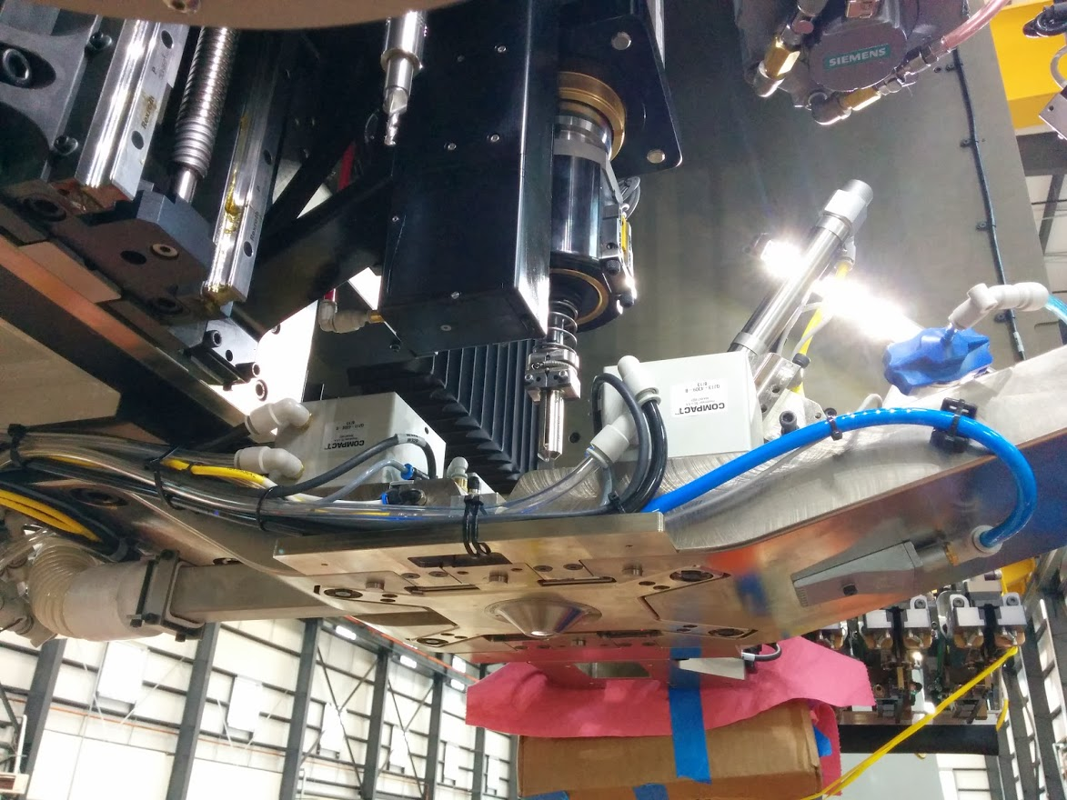
Air Gap Panel Protection
Air gap sensor
Anvil socket
Rivet anvil
Pressure foot/Clamp pad

Slide 37
Normal Rivet Insertion

Slide 38

Normal Rivet Insertion
Rivet tail inserted into hole correctly

Slide 39
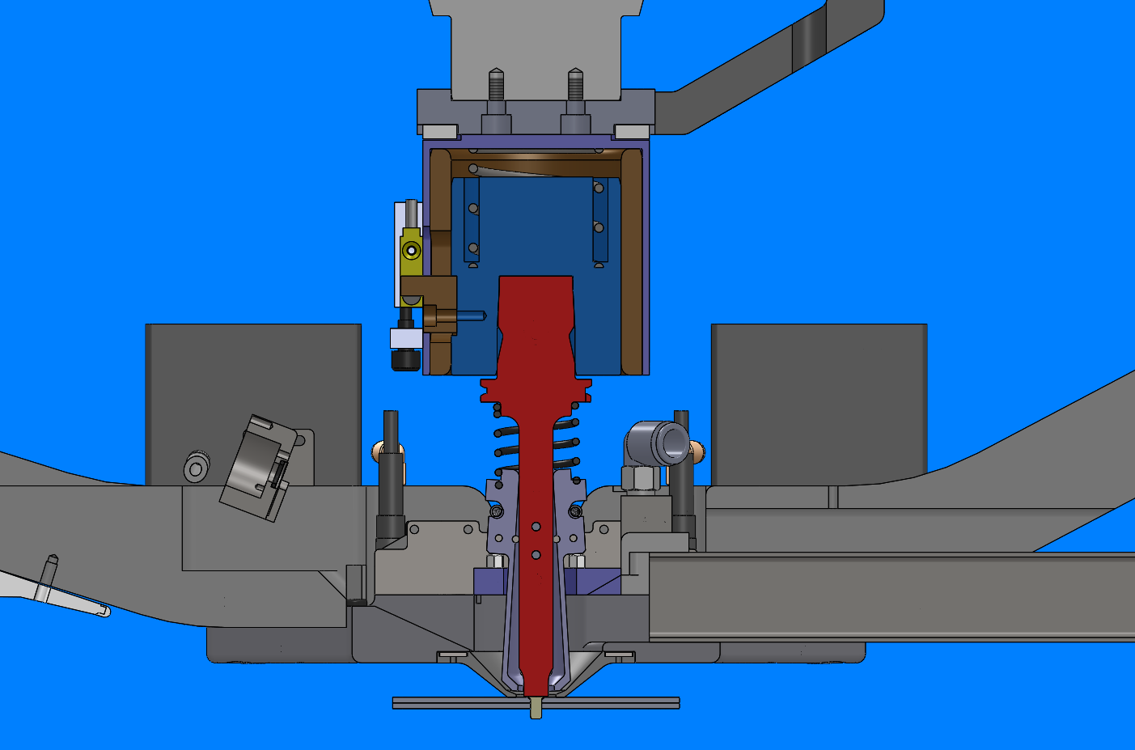
Normal Rivet Insertion
✓
Air gap remains open
Sensor does not detect motion
Fingers release rivet
Rivet is fully inserted, with face of die contacting the rivet head

Slide 40

Normal Rivet Insertion
✓
Axis drives downward to close the air gap
CNC proceeds with rivet upset cycle

Slide 41
Failed Insertion - Jammed

Slide 42

Failed Insertion - Jammed
Rivet tail hits countersink, jamming between the panel and the die face

Slide 43

Failed Insertion - Jammed
✗
Air gap remains partially open – only spring force is applied to the tipped rivet (50 lbs / 220 N)
Sensor detects early motion
CNC stops the cycle before panel damage can occur

Slide 44

Failed Insertion - Laid-down
✗
Air gap system also protects against a laid-down rivet

Slide 45

Bolt/Rivet Injector with Integrated Tool Changer

Slide 46

Rivet/Bolt Injector

Slide 47


Injectors & Anvil ATC
Modular injector system holds several injectors for different fastener types and diameters
Servo indexing axis aligns each injector to the driver
Single injector module
Upper anvil tool change is integrated with the injector system

Slide 48

HORIZONTAL RIVETING MACHINE INJECTOR OVERVIEW
Fastener sent to Injector through feed tubes
Sensor detects fastener’s arrival at Injector

Slide 49

HORIZONTAL RIVETING MACHINE INJECTOR OVERVIEW
Fastener enters Chamber

Slide 50

HORIZONTAL RIVETING MACHINE INJECTOR OVERVIEW
Fastener settles in Catch Blocks

Slide 51

HORIZONTAL RIVETING MACHINE INJECTOR OVERVIEW
Injector Pusher extends and engages fastener’s head and begins pushing towards Fingers

Slide 52

HORIZONTAL RIVETING MACHINE INJECTOR OVERVIEW
Pusher extends fully and snaps fastener into Fingers

Slide 53

HORIZONTAL RIVETING MACHINE INJECTOR OVERVIEW
Pusher retracts and Injector is reset for next cycle

Slide 54

HORIZONTAL RIVETING MACHINE INJECTOR OVERVIEW
Shuttle table moves Driver to drilled hole, injection cycle complete

Slide 55

INJECTOR EJECTION EXAMPLE
Backwards fastener sent to Injector
(Same procedure occurs for multiple fasteners sent, etc.)

Slide 56

HORIZONTAL RIVETING MACHINE INJECTOR OVERVIEW
Backwards fastener enters Chamber

Slide 57

HORIZONTAL RIVETING MACHINE INJECTOR OVERVIEW
Backwards fastener settle on Catch Blocks

Slide 58

HORIZONTAL RIVETING MACHINE INJECTOR OVERVIEW
Pusher attempts to extend but cannot extend due to backwards fastener
(Same happens when multiple fasteners are sent at the same time)

Slide 59

HORIZONTAL RIVETING MACHINE INJECTOR OVERVIEW
After a timeout which indicates a jam, the Pusher retracts.

Slide 60

HORIZONTAL RIVETING MACHINE INJECTOR OVERVIEW
Bombay Ejection Doors open and Fastener is blown out
(In the case of multiple fasteners fed, all fasteners are cleared from the Injector at this point)

Slide 61

HORIZONTAL RIVETING MACHINE INJECTOR OVERVIEW
Bottom view of Injector with Bombay Doors open

Slide 62

HORIZONTAL RIVETING MACHINE INJECTOR OVERVIEW
Bombay Doors close and Injector is reset to receive the next fastener

Slide 63

Rivet Injector Bomb Bay Doors Closed

Slide 64

Bomb Bay Doors Closed

Slide 65

Bomb Bay Doors Open

Slide 66


Resync Camera System
Macro Lens
High Resolution Digital Camera
LED Light Ring
Keyence Flushness Measurement
Locating Base

Slide 67




Automatic Resync on Tacks or Drilled holes
Cognex VisionPro Software
Color Camera
Variable LED brightness
Tacks detected even with poor surface conditions

Slide 68


OPTIONAL:
Rivet Flushness Measurement
High Accuracy Laser displacement sensor
Red laser with CCD sensor
150mm +/- 40mm measurement range
0.12mm x 4.2mm beam spot
  Wide spot reduces surface roughness noise
0.25µm repeatability
Sample rates of 2.5-1000µs (selectable)
IP 67
Robust measurement technology
  high-end optics and controller perform repeatably under varying light and surface conditions

Slide 69

OPTIONAL:
Drill ATC

Slide 70


Automatic Drill Tool Changer

Slide 71

Drill ATC
Tool holder slides directly into gripper
3
2
4
1
5
12
6
11
7
10
8
9

Slide 72

ATC Loading
Use buttons to cycle through positions

Slide 73

ATC Loading
Use buttons to cycle through positions

Slide 74

Lower Ram

Slide 75

MAJOR COMPONENTS
Lower process head assembly
Z-sled
Z-axis drivetrain

Slide 76

Lower Tool 1/4in

Slide 77

Lower 1/4in Tool

Slide 78

LOWER PROCESS HEAD
C axis rotation of +/-190deg
Lower anvil
Edge margin tracer
Clamp cylinder
C-axis drivetrain
Load cell

Slide 79

Lower Process Head

Slide 80


Lower Anvil Tools
Electroimpact will provide straight tooling and offset tooling for 5/32” , 6/32” & 8/32” riveting

Slide 81



Fastener Feed System
F2C2 fastener feed 16 slot cartridge rack
Cartridge filling station with vibratory bowls

Slide 82
Electroimpact
Panel Riveting Dept.
Removable/Adjustable Part Holding Fixture

Slide 83

Picture Frame

Slide 84

Picture Frame
ISO
TOP DOWN
SIDE
END ON

Slide 85

Overview
Form Board 1
Machine Interface
Intermediate
Form Boards
2 and 3
Removable
Aluminum Frame
Form Board 4
X Index Plates
Machine Interface
Picture Frame Structure

Slide 86

Overview
Current ARJ machine part holding fixture

Slide 87

Overview

Slide 88



Flexible Part Holding System
Part Holding adapts to parts
Index Boards and Intermediate Boards slide along the structure
Boards will index to specific locations for different panels
Aluminum frame holds Boards and can be removed from structure
Tapered Panel
Crown Fuse Panel
Largest Panel

Slide 89



Form Board Location Index
Index Plates can be
re-machined to add index locations
Form Boards pinoff at index locations

Slide 90

Form Board Location Index
Part Marking
Slotted Pinoff Bushings
Mounting Location
Mounting Location
2x 8mm Index Hole
(Corresponds to Index Holes
in Picture Frame)
Panel Index Designation
X-Index Locating Plate

Slide 91


Form Board Overview
Edge Index
and Clamp
FWD Surface Index
Edge Index
and Clamp
Sliding Surface Indexes
Form Board
Location Index

Slide 92


Form Board Overview

Slide 93



Sliding Indexes
Sphere Surface Index
Sphere Index allows for misalignment of part, while still providing index along its axis
Alpha Numerical Index Locations
Each sliding index has multiple index locations for different panel sizes. Each panel style is assigned a letter.
Plates can be removed and new index locations can be added

Slide 94



Sliding Index
Sliding Indexes move to contact surface
Different index locations for each panel

Slide 95


Edge Index Clamp
Clamping Arm
1. Spherical Index
3. Straight and
Diamond Pin
2. Manual
Toggle Clamp
Clamp shown providing index to edge of panel
Clamp will locate off of edge clamp index plate (shown above)
Edge clamp index plates can be re-machined to allow for new panels
4. M8 Thumb Screw

Slide 96


Edge Index Clamp

Slide 97

Edge Clamp
Similar clamps will be used on all form boards to clamp the edges of the panel
Total of 8x per panel

Slide 98


FWD Edge Clamp
Clamp Arm
Bumper Clamp
Bumper Arm
Index Plate
Toggle Clamp
Index Callouts
Clamps can also be replaced with Lug Indexes depending on customer requirements
Thumb Screws

Slide 99

Intermediate Form Board
Edge Clamp
Sliding/Retract
Surface Indexes
Form Board
Location Index

Slide 100

Form Board Overview

Slide 101


Intermediate From Boards
Because the intermediate form boards are under the panels, they block hole locations during drilling.
They need to be moved after the first machine pass to allow machine to drill all holes.

Slide 102



Sliding/Retract Surface Index
Sphere Index can be retracted 100mm, while the slider plate remains in position.
This allows the Intermediate board to move while under a panel after first machine pass.

Slide 103


Intermediate Edge Clamp
Edge clamps on these boards also have retract feature
Clamp is now open and retracted, ready for form board to move to next location

Slide 104

Loading Method
Step 1: All index locations are
set on an offline frame

Slide 105


Loading Method
All edge clamps are opened

Slide 106


Part Loading
Panel is loaded into the frame VIA crane or by hand.
Lugs or Edge Indexes can be used to locate in the fixture

Slide 107

Edge Clamp
Clamps can now be applied to secure the panel

